Slide 1
Welcome, young apprentices!
Day 3

Slide 2
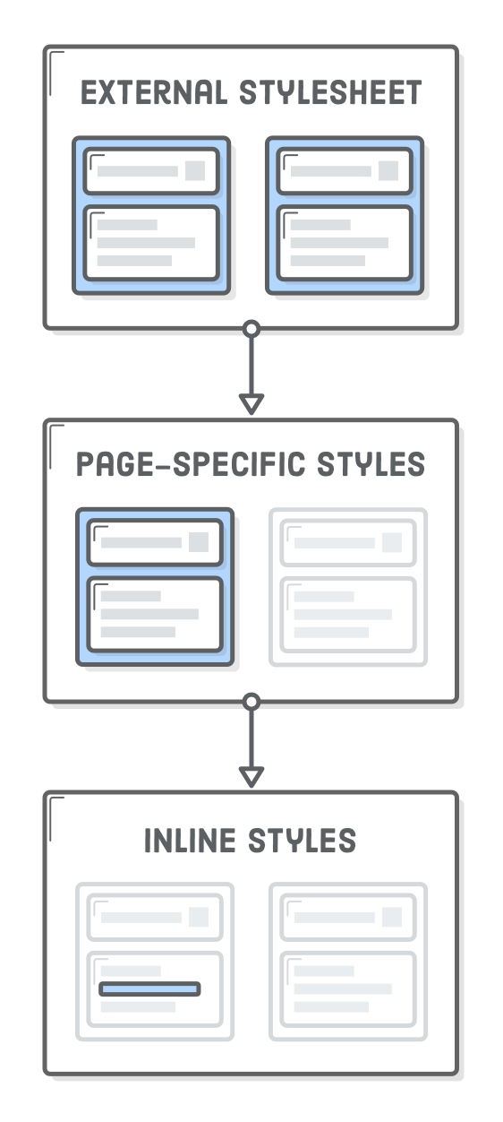
Notes:
C u CSS, kaskada. Redoslijed učitavanja i primjenjivanja stilova. Stilovi postavljeni na parent elementu će se kaskadno primjenjivati na sve child elemente.

Slide 3
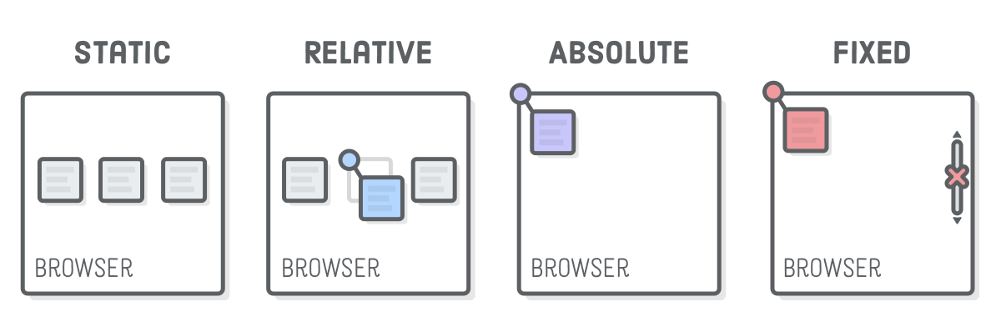
Element position

Slide 4
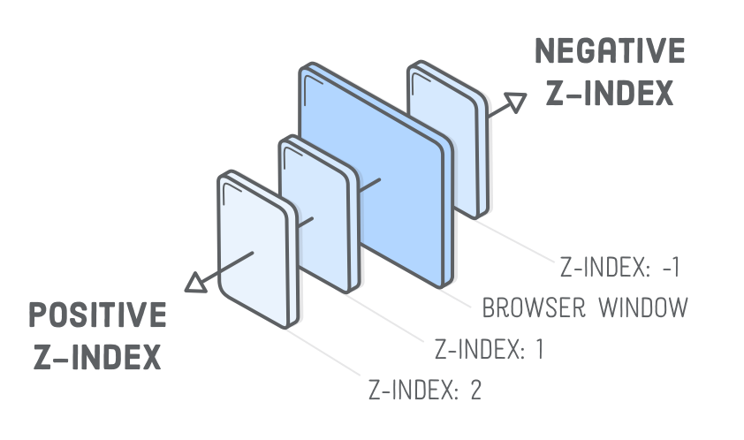

Slide 5
div { position: relative }
div > p { position: absolute; top: 10px; right: 30px; bottom: 10px; left: 20px; z-index: 10; }

Slide 6
CSS Reset
Different browsers have different default
Reset only the things you need
* { margin: 0; padding: 0; box-sizing: border-box; }

Slide 7
Responsive layouts
<meta name="viewport" content="width=device-width, initial-scale=1"> @media (max-width: 768px) { body { flex-direction: column; } }

Slide 8
Mobile-first or Desktop-first?
@media (min-width: 768px) { body { flex-direction: column; } }
@media (max-width: 768px) { body { flex-direction: column; } }

Slide 9
Fancy Fonts
@font-face { font-family: 'robotoregular'; src: url('/fonts/roboto-regular.woff') format('woff'), url('/fonts/roboto-regular.woff2') format('woff2') }
h1 { font-family: 'robotoregular'; }

Slide 10
Difference between display: none & visibility: hidden

Slide 11
Resources

Slide 12
www.w3c.org
www.w3schools.com
https://developer.mozilla.org/
www.css-tricks.com
www.csswizardry.com
www.smashingmagazine.com
www.alistapart.com
https://tympanus.net/codrops/
www.stackoverflow.com
www.github.com
https://css-tricks.com/the-c-in-css-the-cascade/
https://code.tutsplus.com/tutorials/the-30-css-selectors-you-must-memorize--net-16048
https://medium.freecodecamp.org/its-not-dark-magic-pulling-back-the-curtains-from-your-stylesheets-c8d677fa21b2
https://css-tricks.com/snippets/css/a-guide-to-flexbox/
https://css-tricks.com/css-is-awesome/
https://alistapart.com/article/dao

Slide 13
Exercise time!

